Slide 1
Code: 2023FS-COMP_SCI-5567-0001 Deep Learning
_project-2
Name: Ramya Kumari

Slide 2
143.6M
Dee |› L e a I n i to g Net\’vo I k A na lyze i
Analysis for trainNetwork usage
Na m e: not
Ana lysis date: 01- D oc-?'J?? 17:30: 7
47
0
00
A N A LV S I S RE SULT
Name
Type
Aclivalions
Lcarnablc Proper...
SQ”
to iJ ' 1 1
elri 1 1
i n Lit
co n v1 _1
224(6) ^ 224(S) ^ G4(C) ^ l(D)
'.'lei°. 3 x 3 x 3 Eias l l G4
rel Li 1 1
elri 1_2
t t ›r ' 1 2
2 24 ( S 1 224{ 5 ) G4{ C ) 1 ( B 1
r el ri1 2
724(S) x 23A(S) x 8A(C) x {(R)
elri2 1
2-E' one olution
'eig. 3 » 3 » G=
Eias l » l » U8
r eI ri? 1
'ei... 3 3 120:
bin: 1 » 1 » 128
elrid 1
elri2_2
cont 3 1
2-E' one olution
'.'lei... bias
3 » 3 » 12a°...
l l ?5G
i el u?_1
conv3 2
2-E' one olution
'.lei... ? »? » 25G...
bio: l » l » 25G
cIri3 4
55 ( S )
55 S )
2 55 ( C 1
'L B )

Slide 3
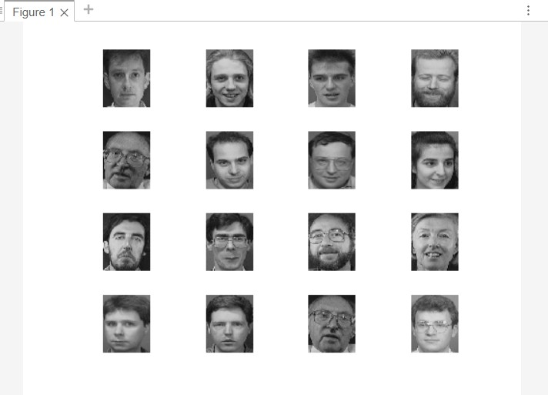
Download the Vgg19 On Addons. Get Face Recognition using AlexNet
'MiniBatchSize', 10, ...
'MaxEpochs', 6, ... 'InitialLearnRate', 1e-4, ... 'Shuffle', 'every-epoch', ... 'ValidationData', augimdsValidation, ... 'ValidationFrequency', 3,
...
'Verbose', false, ... 'Plots', 'training- progress');

Slide 4

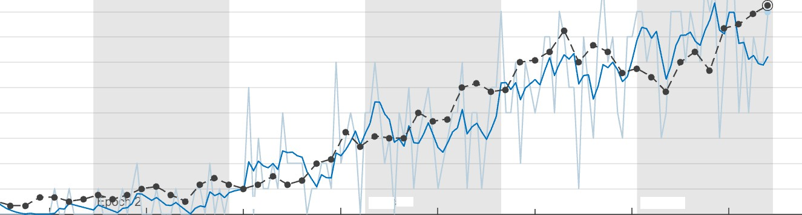
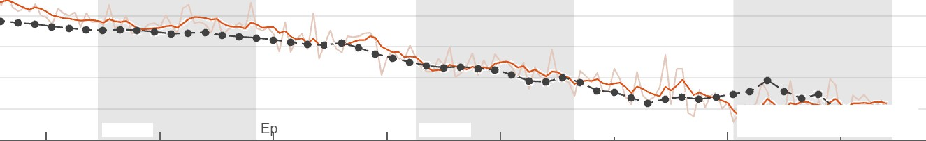

01-Dec-2023 20:12:55)
Results
Validation accuracy: Training finished:
Gaining Progress (01-Dec-2023 20:12:55)
82.S0°A
Max ep•
Training Time Start time: Elapsed time:
01—Dec 20 min
Final
Training Cycle Epoch: Iteration:
Iterations per epoch: Maximum iterations:
6 of 6
168 of 1
28
168
Validation Frequency:
3 iterati•
Other Information Hardware resource: Learning rate schedule: Learning rate:
Epcch 3
60
Epo‹ h 4
Single (
Epoch 5
120
Epoch 6
Constat 0.0001
20
40
80
100
140
160
Iteration
'* "
Learn more
Accuracy
Training (smooth Training Validation
- •@ -
Epoch 2
och 3
60
Epoch 4
Epoch 5
120
Epoch 6
” °@) Final
Loss
20
40
80
100
140
160
Training (smooth

Slide 5
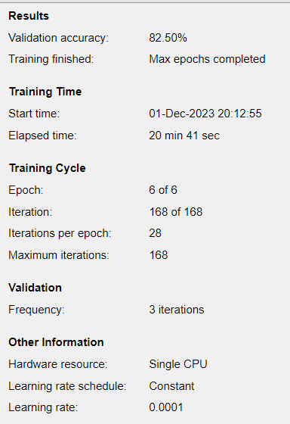
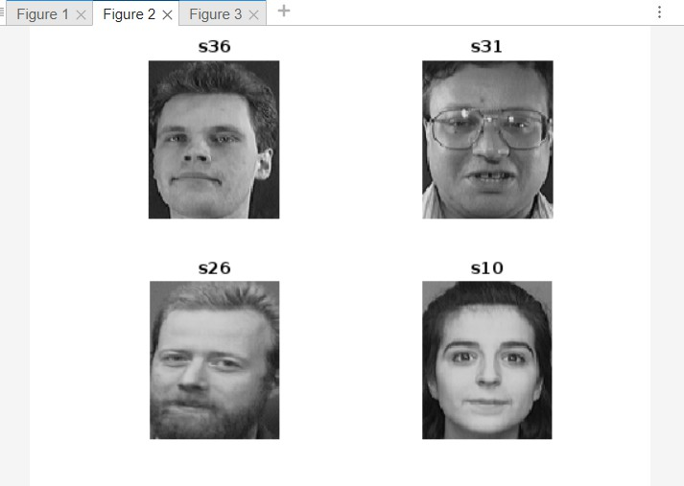
Face Recognition using AlexNet: Validated Images

Slide 6
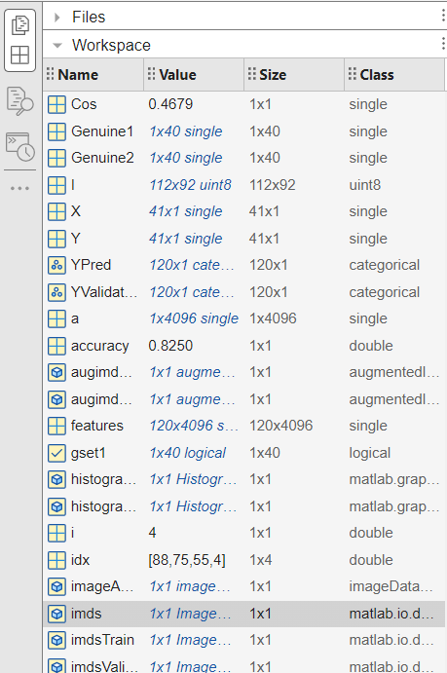
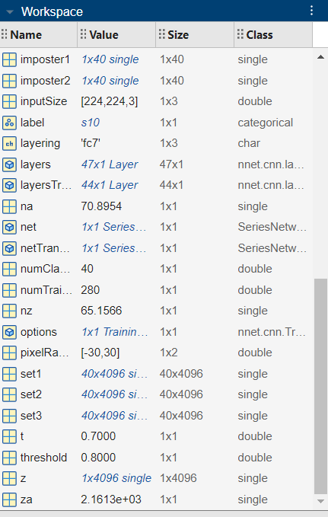
Workspace

Slide 7
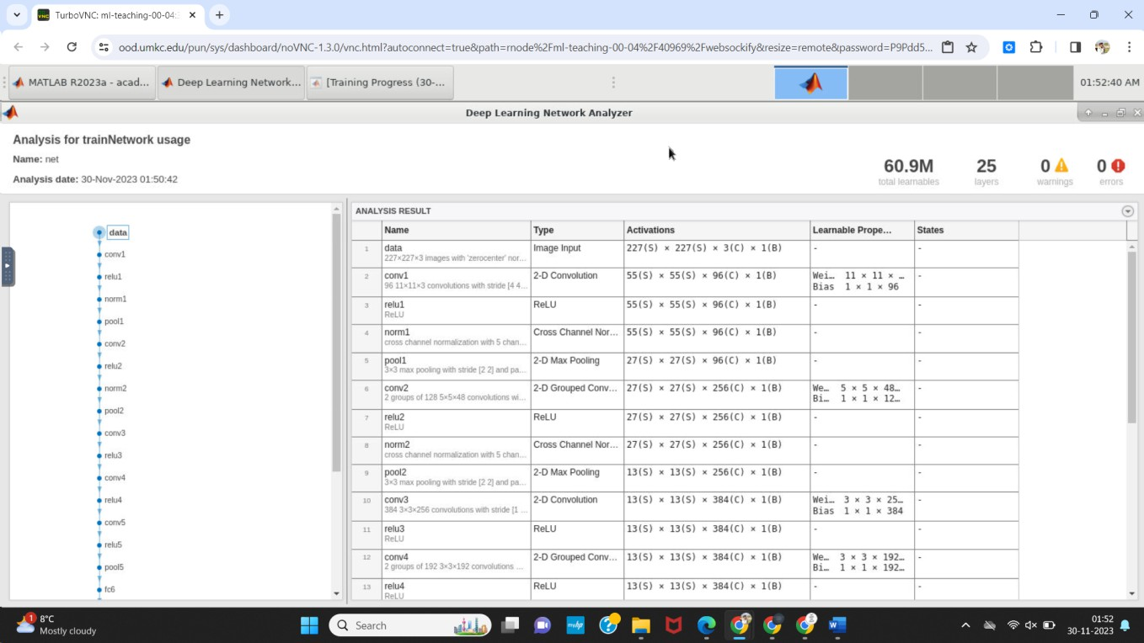
Analysis Face Recognition using AlexNet. Training the network with modified data, Training Parameters 9 Epochs, Mini batch size 12

Slide 8
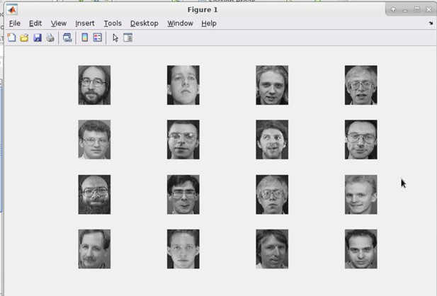
Training the network with modified settings

Slide 9
Epochs: 6 ; Batch size: 10; Validation accuracy: 71.67%. And default settings indicate the model achieved 71.67% accuracy on the validation set with limited training epochs and a moderate batch size.
Modified data Epochs: 9 ; Batch size: 12; Validation accuracy: 85%
Changing the settings to 9 epochs and a batch size of 12 resulted in a substantial increase in validation accuracy to 85%. The improvement from 71.67% to 85% in validation accuracy highlights the effectiveness of the changes.

Slide 10
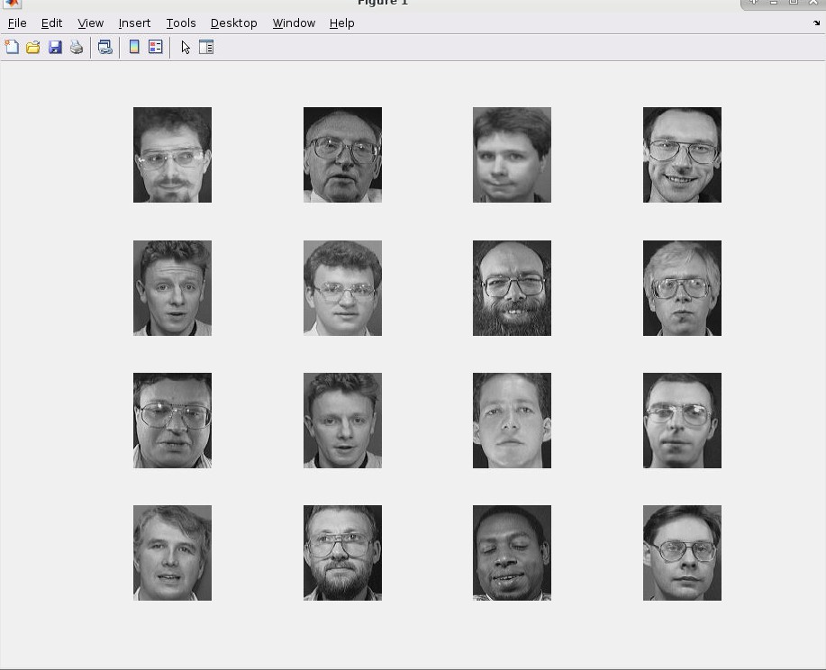
Second Part: VGG19 Face Recognition

Slide 11
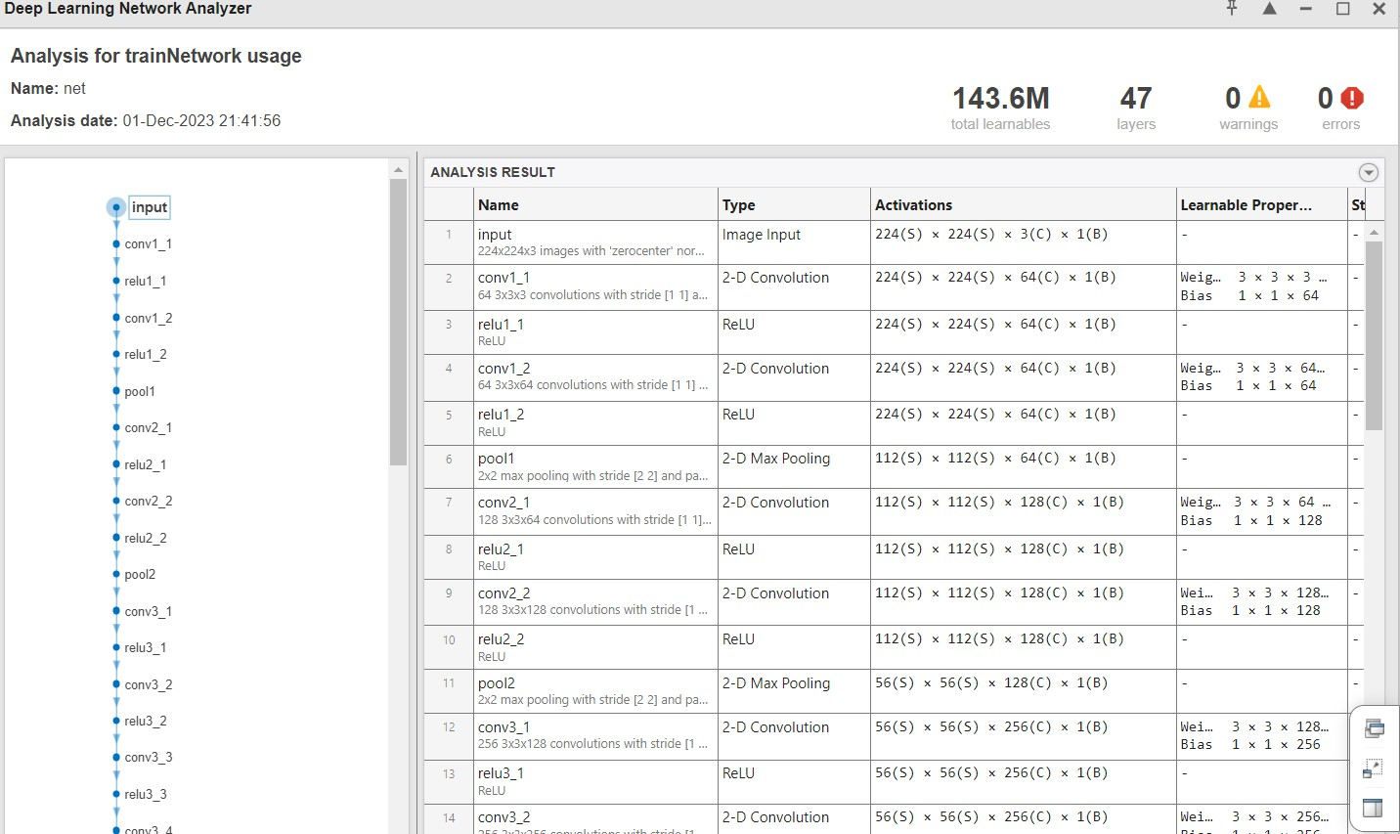
Default settings training network Training Parameters with 6 Epoches ; Mini batch size = 10

Slide 12
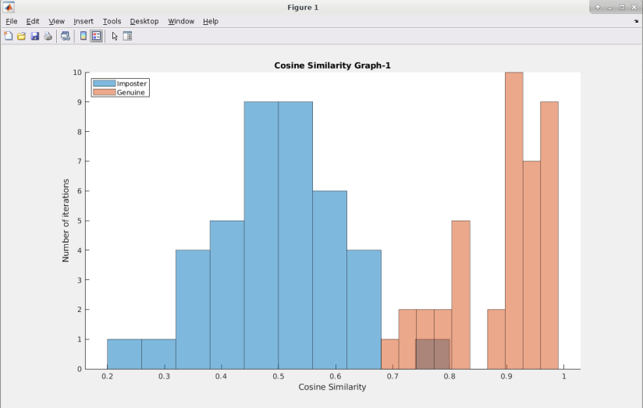
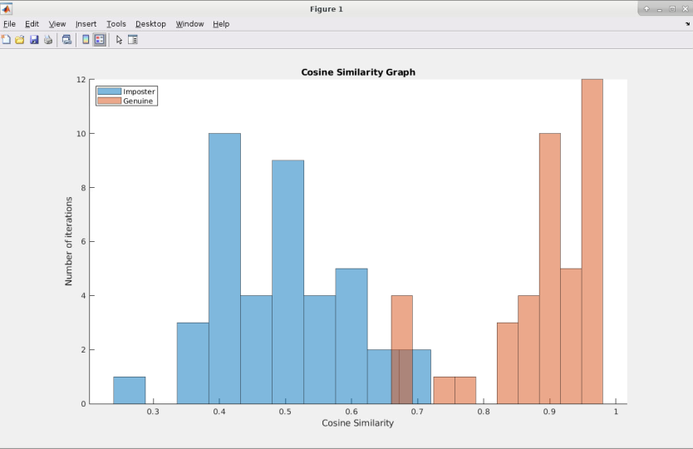
Histogram

Slide 13
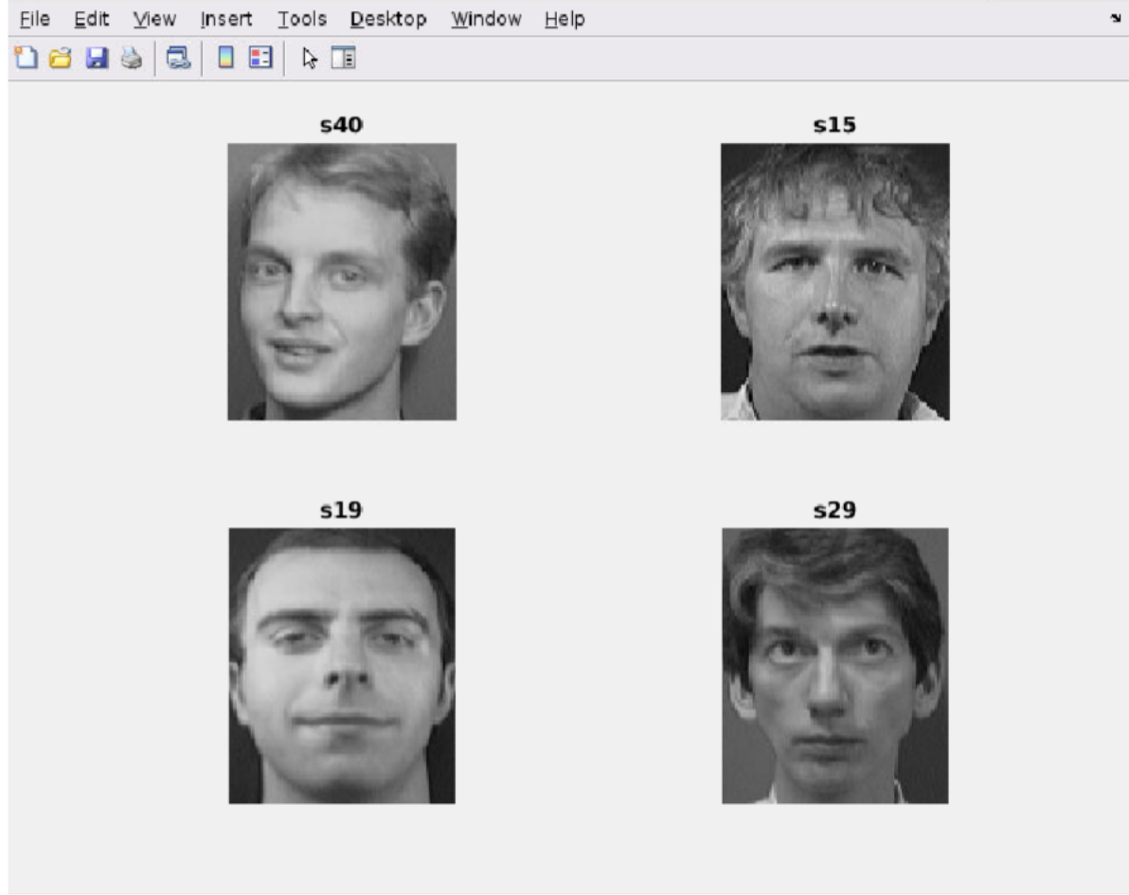
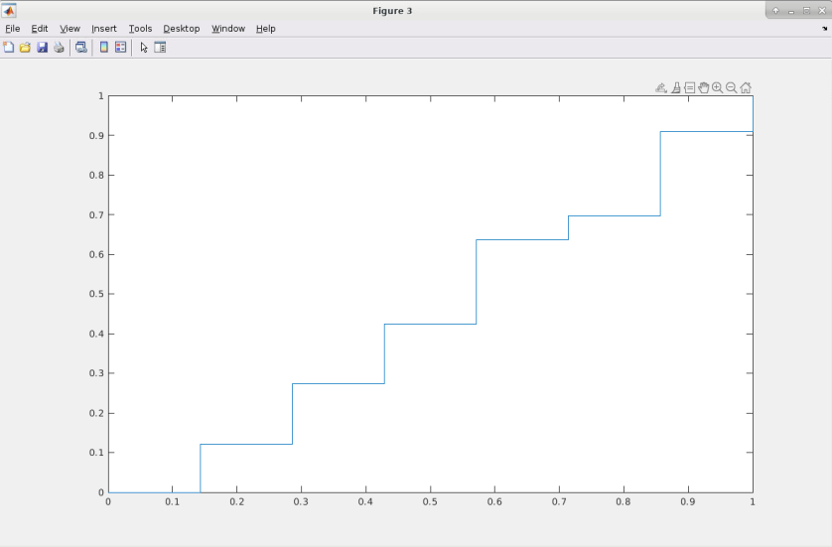
Roc curve verificatgion

Slide 14
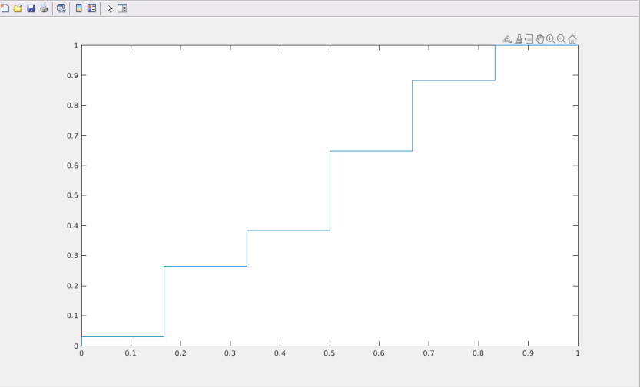
Connect VGG-19 network ;Max epochs 6; Mini batch size 10; Validation accuracy: 89.16%; VGG-19 network achieved an 89.16% validation accuracy.
The Analyzing histograms: The cosine similarity between genuine and imposter scores for certain image pairs and showed more overlap compared to others.
The ROC curve observations: Among different verification scenarios, the ROC curve for the second verification exhibited the highest AUC score when compared to the ROC curve of the first verification

